Slide 1
Testing Concepts - 2

Slide 2
Requirement Management

Slide 3
Requirement Traceability Matrix
One of the key objectives of any testing venture is to ensure that the application under test is behaving as per the functional specification. To ensure this the key objective will be to test all the functionalities or the requirements as it is stated by the customer. Hence Test Coverage becomes a very critical metric for any Testing venture.

Slide 4
Requirements Traceability
Requirement Traceability is very effective tool to ensure the test coverage. Traceability ensures completeness, that all lower level requirements
come from higher level requirements, and that all higher level requirements are allocated to lower level requirements. Traceability is also used to manage change and provides the basis for test planning.

Slide 5
Components
The following components should be mapped using the RTM so that all the test artifacts can be traced:
Test Requirement
Test Strategy
Test Plan
Test Scenario
Test Cases
Defect ids

Slide 6
Requirement Traceability
Forward traceability looks at the following:
Tracing the business requirements to their resulting test requirement(s) to ensure the completeness of the product requirement specification.
Tracing each unique test requirement forward into the design or strategy that test that requirement, and the tests that validate that requirement and so on. The objective is to ensure that each requirement is thoroughly tested.
Backwards traceability looks at the following:
Tracing each Test back to its associated requirement. Backward traceability can verify that the requirements have been kept current with tests.
Tracing each requirement back to its source(s).

Slide 7
Configuration Management

Slide 8
Configuration Management
The purpose of configuration management is to establish and maintain the integrity of the products (Components, data and documentation) of the software or system through the project and product life cycle.
Configuration Management (CM) is a "set of activities designed to control change by identifying the work products that are likely to change, establishing relationships among them, defining mechanisms for managing different versions of these work products, controlling the changes imposed, and auditing and reporting on the changes made.“

Slide 9
Important SCM Activities
Identifying and organizing the software configurable items
Maintaining change requests and systematically controlling the changes to the configurable items
Tracking the status of the Configurable items
Review and Audit of the software configuration management activities
The testers need to know two aspects of change:
The characteristics of the change so that modification to the test plan and test data can be made to assure the right functionality and structure are tested.
The version in which that change will be implemented

Slide 10
Configurable Vs Non-Configurable Items
Project may contain Configurable items(CI) as well as Non Configurable items(Non-CI)
Example for Configurable Items:
Test Plan
Test case Design
Example for Non-Configurable Items:
MOM
Weekly status report

Slide 11
Process involved in SCM
Forming SCM Team
Creating Project Library structure
Define and create User groups and Access control
Archival of Project Items

Slide 12
Forming SCM Team
Team which takes care of SCM Activities by creating PROJECT LIBRARY STRUCTURE

Slide 13
Some benefits of SCM Tool
Keep back up of all work products
Track which person changes what and when
Doesn’t allow more than one person to make modifications at the same time
Helps the Top level management to Track progress

Slide 14
Define and create User groups and Access Control
User Groups Access Control
Management Read
SCM Coordinator/PL Full Control
TL Read/Write
Team members Read/Write

Slide 15
Archival of the Project item
Maintaining Hardcopies and softcopies of the work products

Slide 16
Defect logging and test management tool

Slide 17
Defect Management
Defect Management
What is a defect
Types of defects
Defect life cycle
Defect reporting
Defect management
Defect management Tools

Slide 18
What is a Defect
Any non conformance is a defect
A deviation from specifications, whether missing, wrong, or extra
Anything that causes customer dissatisfactions, whether in the requirements or not

Slide 19
Types of Defect
Functionality Defects
Programming Defects
Logical Defects
Standards
Database Interface
Environmental defects

Slide 20
Defect Life Cycle
Defect life cycle / stages
New
Open
Pending
Fixed
Reopen
Close

Slide 21
Defect Life Cycle
New: Tester reports new defect detected in the application
Pending: Any defect waiting for a decision from a technical manager before a developer addresses the problem.
Open: After pending state the bug will have Open state until the developer fixes it
Fixed: Developer can fix the bug or can reject the bug
Closed/Reopen: After regression test, the tester either closes the bug ( if it solves the error) or reopens the bug

Slide 22
Defect Reporting
Need for Defect Reporting:
Used to describe and quantify deviations from requirements
To correct the defect
Report the status of the application
Gather statistics used to develop defect expectations in future applications
Improve the software development process

Slide 23
Defect Reporting: Severity
Extent to which the bug will affect the system:
Very high | System Crash or loss of data
High | Functionality not available
Medium | Functions works with minor errors
Low | Cosmetic or trivial

Slide 24
Test Models

Slide 25
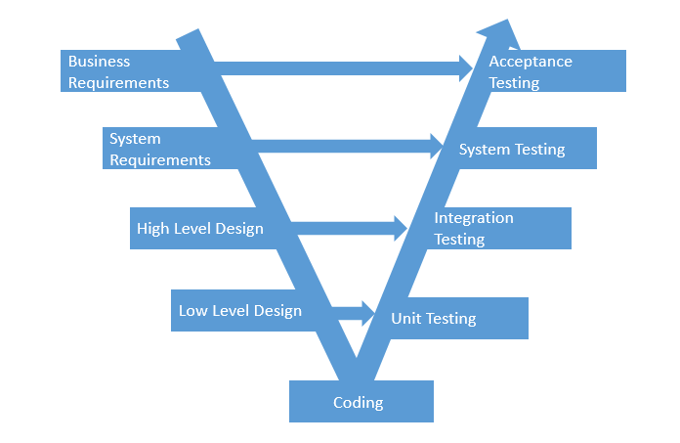
Life Cycle V- Model

Slide 26
V- Model
SDLC Phase | Test Phase
Requirements | Build Test Strategy. Plan for Testing. Acceptance Test Scenarios
Specifications | System Test Case Generation
Architecture | Integration Test Case Generation
Detailed Design | Unit Test Case Generation

Slide 27
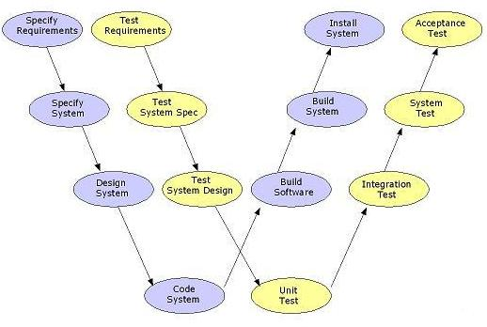
Life Cycle W- Model

Slide 28
Queries ?

Slide 29
For more information please contact: T+ 33 1 98765432 F+ 33 1 88888888 M+ 33 6 44445678 firstname.lastname@atos.net

